Slide 1
Archit Enterprises
System Specification

Slide 2
Interface
- Must be able to clearly display all problems with the robot.
- Must be able to categorize problems based on severity to the entire system
- Must provide appropriate options to fix a given problem
- Must update in real time to give user the most up-to-date information
- Must be able to display individual program components

Slide 3
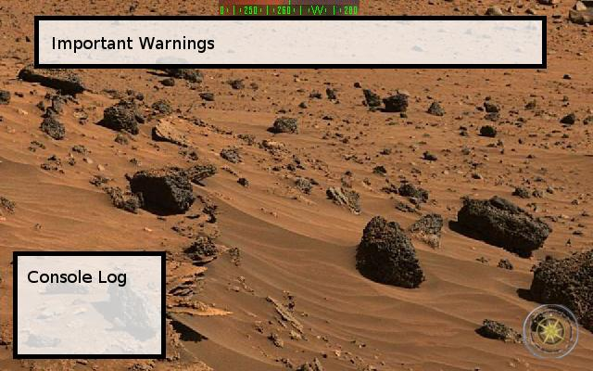
Interface Demonstration

Slide 4
Use Cases
Stopping a process
- System must be able to recognize that a process needs to be halted.
- If that condition is met, system must be able to halt the specific process.
- System must run next process in queue or allow user to decide which process to run next
Stopping all processes
- System must be able to recognize if all processes need to be halted.
- If this condition is met, system must be able to stop all process.
- System then needs to be able to present the user with the option to completely reboot the robot or restart from the problem location.

Slide 5
Use Cases
Repairing a problem
- System must recognize the problem based on outside input and user input
- Once a problem is identified, system must be able to diagnose problem appropriately using the user input
- System must be able to return to prior program or a user defined program
Manipulating program data
- System has identified a problem, must be able to manipulate program variables to fix it
- Provide window or fields for user to manipulate program data
- System must be able to re-run program with changed program data

Slide 6
Special Implementation Ideas
- Provide users with different notifications for different alert levels (i.e. red for very important, orange for moderately important, yellow for important)
- Provide users with detailed information about the problem (i.e. syntactical error, compilation error, etc.)
- Provide users with a GUI that allows for easy manipulation of program variables/breakpoints

Slide 7
Requirements Process
- Generate ideas as a group
- Determine which ideas were appropriate requirements for our implementation
- Hash out details of each individual requirement
- Re-evaluate requirements for completeness and correctness
- Repeat cycle if needed

Slide 8
Functional Description of Communication Protocol
- Must be able to facilitate communication between debugging and control without major interruptions
- Must be able to relay program information from debugging to control and vice versa
- Must incorporate a syntax that allows quick communication between each side without loss of information

Slide 9
Functional Description of Debugging Interface
- Must be able to accurately fix problems without hampering other programs
- Must be able to present user with accurate information in real time
- Must be able to display all pertinent information about each program in an obvious way to the user
- Must be able to allow users to manipulate program code (i.e. breakpoints)

Slide 10
Management Report
- Weekly meeting to finish post-lab 1, finalize work environment and ensure everyone was up to speed on project
- Online meeting over the weekend to complete pre-lab 2
- Each member participated equally in both meetings to complete required documents and presentation
- Next meeting will be this week to begin finalizing specification document

